Slide 1
Super Store Data Analysis
Visualization and Insights for Business Decision Making
ALY6070 - Communication and Visualization for Data Analytics
Professor: Yesha Vora
Date: 25th March 2025
Team Members: Abhijit Bajrang More
Darpan Vitthalbhai Radadiya
Priya Kattigehalli Mata
Siyu Lai
Sukrit Tripathi
Zhiyue Jiang

Slide 2
Introduction to Superstore Sales Dataset
The Superstore dataset consists of transactional data of a retail store, detailing sales, profits, and other metrics.
Key Columns:
Order Date: The date when the order was placed.
Product Category: Categories include Office Supplies, Furniture, and Technology.
Sales: Total sales amount in dollars.
Profit: Profit earned from each sale.
Quantity: Number of items sold.
The dataset includes multiple years of data, making it suitable for year-over-year sales trend analysis.

Slide 3
Data Preparation & Cleaning for Visualization
The data was prepared and cleaned for analysis with these steps:
Date Conversion: "Order Date" was converted into a date format to facilitate time-based analysis.
Category Classification: Converted Product Category into a factor with predefined levels (Office Supplies, Furniture, and Technology).
Missing Data: Ensured there was no missing data in crucial columns like Sales, Category, and Profit.
Tools Used: Data cleaning was performed in Tableau (direct connection to the data source), and R or Python can be used for deeper cleaning if necessary.

Slide 4
Business Insights from the Superstore Sales Data
Product Category Comparison: Visualizations comparing sales across Office Supplies, Furniture, and Technology.
Key Insights:
* Technology has consistently shown higher sales than other categories.
* Office Supplies and Furniture show moderate but comparable sales.
* The trend reveals areas where the company could focus marketing or inventory strategies.

Slide 5
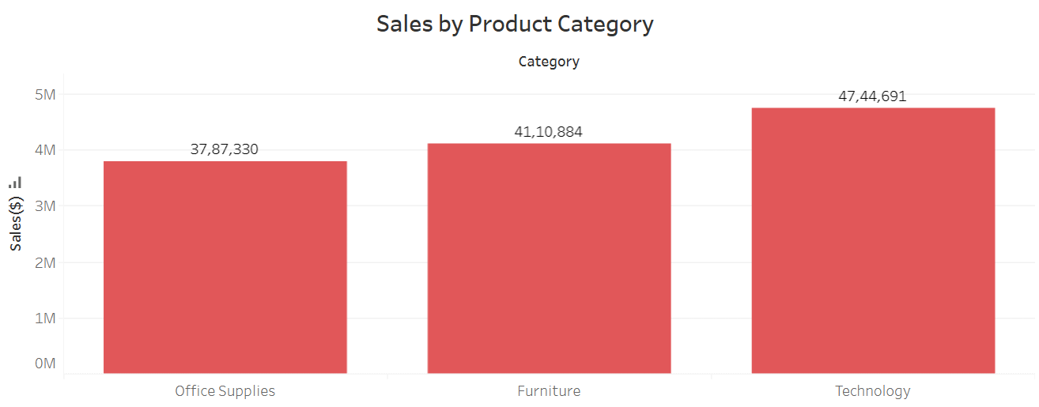
Sales by Product Category
This Visualization provides a comparative analysis of total sales across the product categories (Office Supplies, Furniture, Technology), emphasizing Technology as the leading category in sales performance.

Slide 6
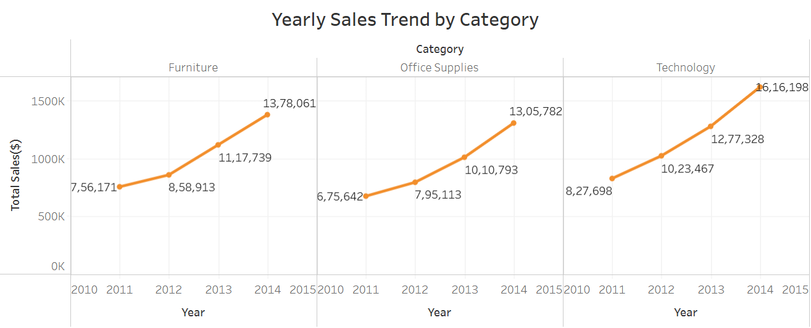
Yearly Sales Trend by Category
This line chart effectively illustrates the growth trajectory of total sales from 2011 to 2014, with a clear upward trend across all categories, particularly highlighting the significant increase in Technology sales.

Slide 7
Key Insights
Technology dominates sales growth, outpacing Office Supplies and Furniture, signaling a shift towards high-tech products.

Slide 8
Recommendations
Prioritize Technology expansion and develop targeted strategies to accelerate sales in Office Supplies and Furniture categories.

Slide 9
Questions?

Slide 10
Thank you!

